Slide 1

Agenda
  Introduction to MUN
  Flow of Debate
  Points and Motions
  How to write an effective speech?
  Research and Preparation
  Position Papers
  Resolution Papers
  Q&A Session

Slide 2
Introduction to MUN
  Model United Nations (MUN) is an exciting simulation of the real United Nations, where students take on the roles of delegates representing different countries. In MUN, you discuss important global issues, debate possible solutions, and work together to create resolutions—just like real diplomats do.
  It’s a great way to improve your public speaking, research, and teamwork skills while learning about international relations.
  Remember, MUN is not just about winning, it's about learning, collaborating, and having fun!

Slide 3
Flow of Debate
Roll Call
Opening The Floor For Debate
Setting The Agenda
Establishing The General Speakers List (GSL)

Slide 4
Flow of Debate
Moderated Caucuses
Unmoderated Caucuses
Resolution Discussion
Closing Committee Sessions

Slide 5
Motions and Points

Slide 6
Motions and Points
  Raising Motions are statements made by delegates in order to direct the debate in a particular direction.
  Multiple motions can be raised and voted upon once recognized by the Chair.
  Purpose of raising motions -
  Set the Agenda
  Introduce a motion to set GSL/MOD/UNMOD/DR

Slide 7
How can we phrase a motion?
  “Delegate of Australia would like to raise a motion to ____.”
  “Delegate of Australia would like to raise a motion to suspend the formal debate and move into Moderated Caucus on the topic ____ for total time being ___ and individual speaker’s time being ____.”

Slide 8
MOTION |  | TO PASS, THE VOTE REQUIRES
MOTION TO SET SPEAKER’S TIME | •THIS IS A MOTION TO SET OR CHANGE THE SPEAKER’S TIME. •IT IS A PROCEDURAL MOTION WHICH REQUIRES 2 DELAGATES SPEAKING FOR THE AMOUNT OF TIME MENTIONED FOR, AND 2 DELEGATES SPEAKING AGAINST. | SIMPLE MAJORITY
MOTION TO OPEN AND CLOSE THE SPEAKER’S LIST | • THE SPEAKER’S LIST CAN BE OPENED AND CLOSED MULTIPLE TIMES. • ONCE THE SPEAKER’S LIST IS EXHAUSTED, IT MEANS NO ONE ELSE WISHES TO SPEAK, DEBATE IS OVER, AND THE COMMITTEE THEN MOVES INTO VOTING PROCEDURE. THIS MOTION REQUIRES AN IMMEDIATE VOTE. | SIMPLE MAJORITY

Slide 9
MOTION |  | TO PASS, THE VOTE REQUIRES
MOTION TO SUSPEND MEETING | • THIS MOTION IS MADE TO SUSPEND THE MEETING FOR THE PURPOSE OF A REGULAR CAUCUS OR A MODERATED CAUCUS, BUT ITS USE ALSO DEPENDS UPON THE CONFERENCE YOU ARE ATTENDING. • WHEN MOVING TO SUSPEND THE MEETING, THE DELEGATE SHOULD SPECIFY A CERTAIN AMOUNT OF TIME AND THE PURPOSE. | SIMPLE MAJORITY
MOTION TO ADJOURN MEETING | THIS MOTION IS MADE TO END THE COMMITTEE SESSION UNTIL THE NEXT SESSION, WHICH AT TIMES IS UNTIL NEXT YEAR. • THIS MOTION IS MOST COMMONLY MADE TO END COMMITTEE SESSION FOR THE PURPOSE OF LUNCH OR DINNER. THIS MOTION REQUIRES AN IMMEDIATE VOTE. | SIMPLE MAJORITY

Slide 10
MOTION |  | TO PASS, THE VOTE REQUIRES
MOTION TO CLOSE DEBATE | THE MOTION TO MOVE INTO VOTING PROCEDURE IS MADE WHEN A DELEGATE BELIEVES THEIR COUNTRY'S POSITION IS CLEAR, ENOUGH DRAFT RESOLUTIONS ARE ON THE FLOOR, AND THE COMMITTEE IS READY. IT REQUIRES TWO DELEGATES TO SPEAK AGAINST THE CLOSURE OF DEBATE, WITH NO DELEGATES SPEAKING IN FAVOR. | 2/3 MAJORITY
POINT OF ORDER | A DELEGATE MAY RAISE A POINT OF ORDER DURING DISCUSSIONS, AND THE CHAIRPERSON WILL MAKE AN IMMEDIATE RULING. IF THE DELEGATE DISAGREES WITH THE RULING, THEY CAN APPEAL, WHICH WILL BE PUT TO A VOTE. THE CHAIRPERSON'S RULING STANDS UNLESS OVERRULED BY A TWO-THIRDS MAJORITY OF THE MEMBERS PRESENT AND VOTING.

Slide 11
MOTION |  | TO PASS, THE VOTE REQUIRES
POINT OF INFORMATION | •AFTER A DELEGATE HAS GIVEN A SPEECH IN FORMAL DEBATE, S/HE MAY CHOOSE TO YIELD HIS OR HER TIME TO A POINT OF INFORMATION, A QUESTION ANOTHER DELEGATE RAISES CONCERNING THE SPEECH.
POINT OF PERSONAL PRIVILEGE | A DELEGATE MAY RAISE A POINT OF PERSONAL PRIVILEGE IN ORDER TO INFORM THE CHAIRPERSON OF A PHYSICAL DISCOMFORT S/HE IS EXPERIENCING, SUCH AS INABILITY TO HEAR ANOTHER DELEGATES SPEECH.

Slide 12
Position Papers
  To write a strong MUN position paper, start with an introduction stating your country’s stance on the topic. Provide background information with key facts and past actions your country has taken.
  Discuss current challenges and propose clear solutions aligned with your nation’s policies. Use formal language, cite sources, and keep it concise. Conclude with a strong statement reinforcing your country’s commitment to the issue.

Slide 13
Rules of Procedure
General Speaker’s List
  The Speakers’ List is the committee's default debate format when no points or motions are raised. Each country can only appear once at a time. Delegates join by raising their placards or sending notes. Speaking time is set by the delegate opening the list but can be changed. Once the list is exhausted, voting begins.
  Delegates must yield remaining time to the Dias or POIs. Yielding to the Dias ends the speech.

Slide 14
How to write a effective speech?
3 points to success:
  To write an effective MUN speech, start by clearly stating your country’s position. Use facts and statistics to support your argument.
  Keep it concise and focused, addressing key issues. Maintain a formal tone, but stay engaging.
  End with a call to action or a solution. Practice speaking confidently, and be ready to respond to questions.

Slide 15
Rules of Procedure
Moderated Caucus (Simple Majority)
  A Moderated Caucus is a structured form of debate that allows delegates to discuss specific topics in a more interactive manner than the Speakers’ List. To initiate a Moderated Caucus, a delegate must propose a motion specifying the overall duration, individual speaking time, and the topic to be discussed.
  Once voted upon by the committee, the Chair will call on delegates who raise their placards to speak for the allotted time. Delegates may yield their time during a Moderated Caucus. The Moderated Caucus continues until the total time elapses or a motion to end it passes, after which the committee returns to the default debate format.

Slide 16
Rules of Procedure
Unmoderated Caucus (Simple Majority)
  An Unmoderated Caucus is a suspension of formal debate, allowing delegates to move freely around the room and engage in informal discussions, negotiate, and draft working papers or resolutions. To begin an Unmoderated Caucus, a delegate must propose a motion specifying the total duration.
  Once the motion passes with a simple majority, delegates may leave their seats, form groups, and collaborate directly with others. There is no formal speaking order or time limit for individual delegates during this period. The Unmoderated Caucus ends once the allotted time expires or a motion to extend or end it is passed, after which the committee resumes formal debate.

Slide 17
Resolution Papers
  A Draft Resolution is an official document requiring chairperson approval before circulation. Sponsors are its writers, while Signatories support discussion without obligations. Delegates cannot be both Sponsor and Signatory.
  After introduction, Sponsors cannot be added but may request removal in writing. If minimum Sponsors are not met, the resolution is removed. Signatories can join or leave anytime with written requests.
  Multiple Draft Resolutions can be on the floor simultaneously.

Slide 18
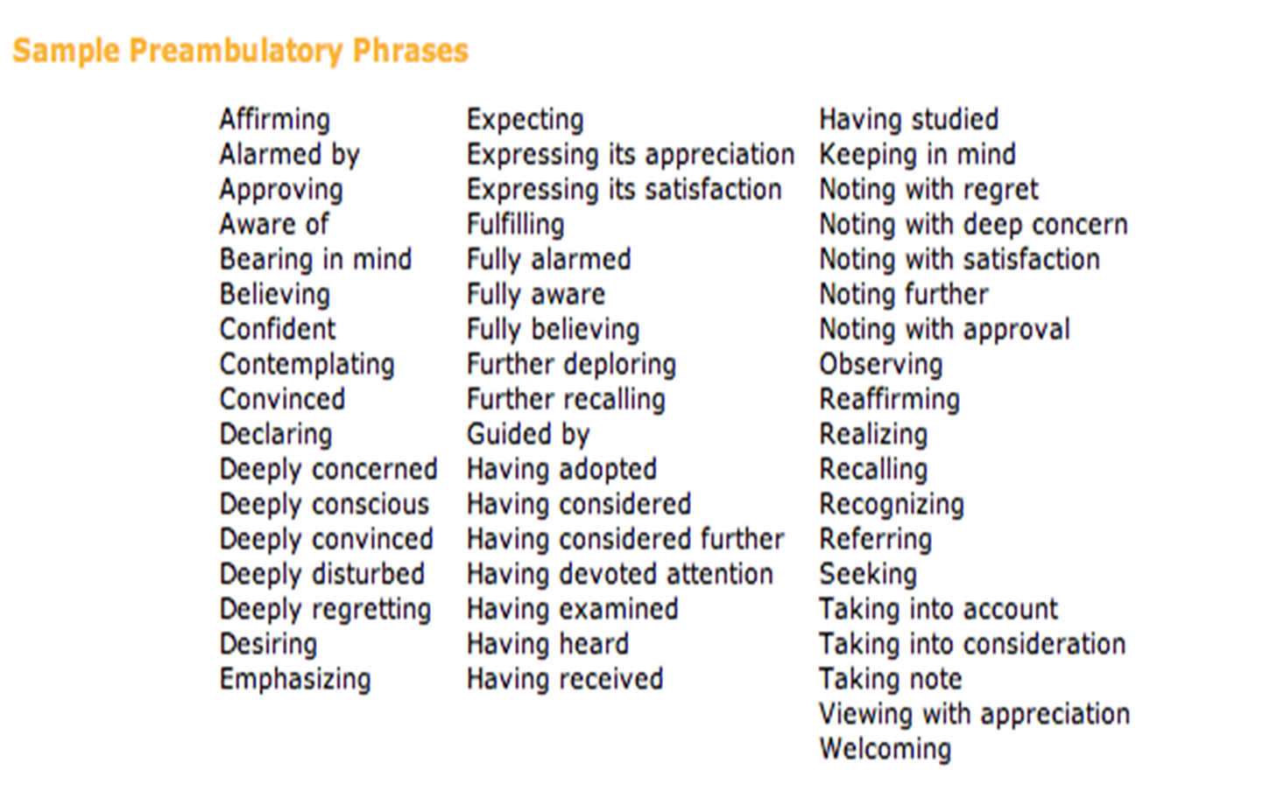
Resolution Papers
  A resolution has three main parts: the heading, the pre-ambulatory clauses, and the operative clauses.

Slide 19
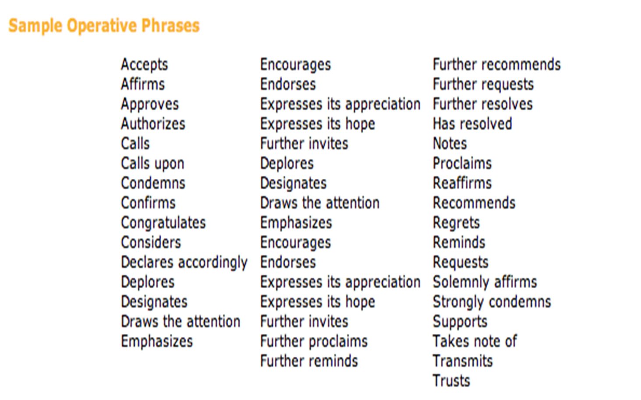
Operative Clauses

Slide 20
Amendments
  An amendment modifies, deletes, or adds parts to a Draft Resolution and must be submitted in writing. Amendments to Perambulatory Clauses are not allowed.
  There are two types: Friendly (agreed by all Sponsors, no vote needed) and Unfriendly (requires a vote). Grammatical errors are corrected without voting. Amendments can be withdrawn in writing before voting.

Slide 21

Q & A
Session

